Slide 1

Convolutional Neural Networks
Computer vision
deeplearning.ai

Slide 2
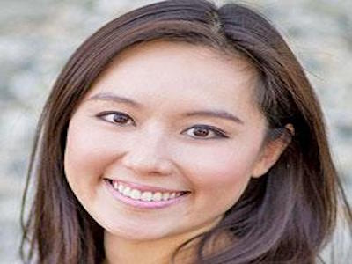
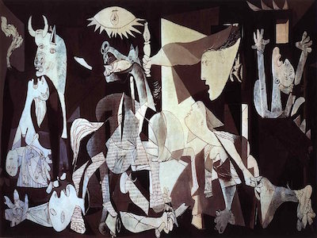
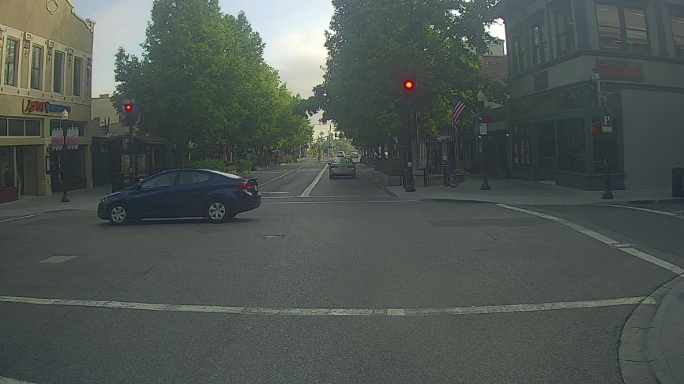
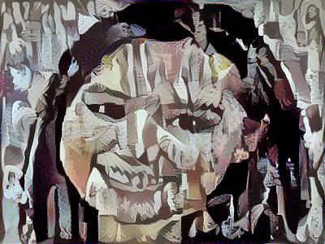
Computer Vision Problems
Image Classification
Neural Style Transfer
Cat? (0/1)
64x64
Object detection

Slide 3







Deep Learning on large images
Cat? (0/1)
64x64
$$x_{1}$$
$$x_{2}$$
$$⋮$$
$$⋮$$
$$⋮$$
$$\hat{y}$$
$$x_{n}$$

Slide 4
Convolutional Neural Networks
Edge detection example
deeplearning.ai

Slide 5
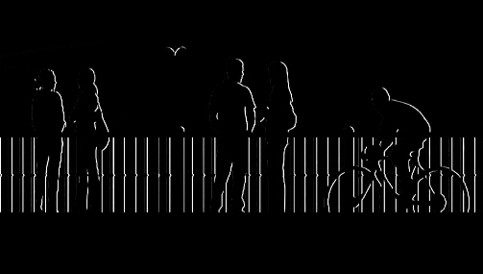
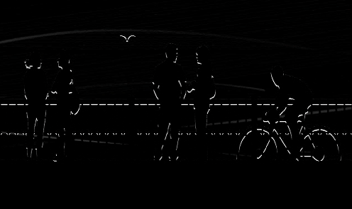
Computer Vision Problem
vertical edges
horizontal edges

Slide 6


Vertical edge detection
1
1
-1
0
1
1
0
-1
-1
-1
0
0
3 | 0 | 1 | 2 | 7 | 4
1 | 5 | 8 | 9 | 3 | 1
2 | 7 | 2 | 5 | 1 | 3
0 | 1 | 3 | 1 | 7 | 8
4 | 2 | 1 | 6 | 2 | 8
2 | 4 | 5 | 2 | 3 | 9
1
1
1
1
1
0
-1
0
-1
1
0
-1
1
1
0
-1
0
-1
-1
-1
-1
0
0
0
1
1
1
1
0
-1
0
0
-1
1
0
0
-1
-1
1
-1
1
0
-1
1
0
-1
0
-1
$$∗$$
$$=$$
1
0
-1
1
0
-1
1
1
0
-1
0
-1
0 | -2 | -4 | -7
-3 | -2 | -3 | -16

Slide 7



Vertical edge detection
10 | 10 | 10 | 0 | 0 | 0
10 | 10 | 10 | 0 | 0 | 0
10 | 10 | 10 | 0 | 0 | 0
10 | 10 | 10 | 0 | 0 | 0
10 | 10 | 10 | 0 | 0 | 0
10 | 10 | 10 | 0 | 0 | 0
0 | 30 | 30 | 0
0 | 30 | 30 | 0
0 | 30 | 30 | 0
0 | 30 | 30 | 0
1 | 0 | -1
1 | 0 | -1
1 | 0 | -1
$$∗$$
$$=$$
$$∗$$

Slide 8
Convolutional Neural Networks
More edge detection
deeplearning.ai

Slide 9



Vertical edge detection examples
10 | 10 | 10 | 0 | 0 | 0
10 | 10 | 10 | 0 | 0 | 0
10 | 10 | 10 | 0 | 0 | 0
10 | 10 | 10 | 0 | 0 | 0
10 | 10 | 10 | 0 | 0 | 0
10 | 10 | 10 | 0 | 0 | 0
0 | 30 | 30 | 0
0 | 30 | 30 | 0
0 | 30 | 30 | 0
0 | 30 | 30 | 0
1 | 0 | -1
1 | 0 | -1
1 | 0 | -1
$$∗$$
$$=$$
0 | 0 | 0 | 10 | 10 | 10
0 | 0 | 0 | 10 | 10 | 10
0 | 0 | 0 | 10 | 10 | 10
0 | 0 | 0 | 10 | 10 | 10
0 | 0 | 0 | 10 | 10 | 10
0 | 0 | 0 | 10 | 10 | 10
0 | -30 | -30 | 0
0 | -30 | -30 | 0
0 | -30 | -30 | 0
0 | -30 | -30 | 0
1 | 0 | -1
1 | 0 | -1
1 | 0 | -1
$$∗$$
$$=$$

Slide 10

Vertical and Horizontal Edge Detection
1 | 0 | -1
1 | 0 | -1
1 | 0 | -1
1 | 1 | 1
0 | 0 | 0
-1 | -1 | -1
Vertical
Horizontal
10 | 10 | 10 | 0 | 0 | 0
10 | 10 | 10 | 0 | 0 | 0
10 | 10 | 10 | 0 | 0 | 0
0 | 0 | 0 | 10 | 10 | 10
0 | 0 | 0 | 10 | 10 | 10
0 | 0 | 0 | 10 | 10 | 10
0 | 0 | 0 | 0
30 | 10 | -10 | -30
30 | 10 | -10 | -30
0 | 0 | 0 | 0
1 | 1 | 1
0 | 0 | 0
-1 | -1 | -1
$$∗$$
$$=$$

Slide 11
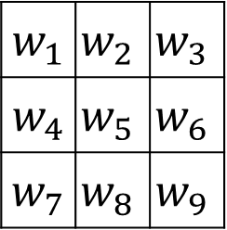
Learning to detect edges
1 | 0 | -1
1 | 0 | -1
1 | 0 | -1
3 | 0 | 1 | 2 | 7 | 4
1 | 5 | 8 | 9 | 3 | 1
2 | 7 | 2 | 5 | 1 | 3
0 | 1 | 3 | 1 | 7 | 8
4 | 2 | 1 | 6 | 2 | 8
2 | 4 | 5 | 2 | 3 | 9
$w_{1}$ | $$w_{2}$$ | $$w_{3}$$
$w_{4}$ | $$w_{5}$$ | $$w_{6}$$
$w_{7}$ | $$w_{8}$$ | $$w_{9}$$

Slide 12
Convolutional Neural Networks
Padding
deeplearning.ai

Slide 13


Padding
$$∗$$
$$=$$

Slide 14
Valid and Same convolutions
“Valid”:
“Same”: Pad so that output size is the same as the input size.

Slide 15
Convolutional Neural Networks
Strided convolutions
deeplearning.ai

Slide 16

Strided convolution
2 | 3 | 7 | 4 | 6 | 2 | 9
6 | 6 | 9 | 8 | 7 | 4 | 3
3 | 4 | 8 | 3 | 8 | 9 | 7
7 | 8 | 3 | 6 | 6 | 3 | 4
4 | 2 | 1 | 8 | 3 | 4 | 6
3 | 2 | 4 | 1 | 9 | 8 | 3
0 | 1 | 3 | 9 | 2 | 1 | 4
3
4
4
3
4
3
4
4
4
1
0
2
1
0
1
2
0
2
-1
0
3
4
4
-1
3
0
-1
3
4
4
3
0
3
3 | 4 | 4
1 | 0 | 2
-1 | 0 | 3
3
4
4
1
0
1
0
2
$$=$$
2
1
0
2
$$∗$$
-1
0
3
-1
0
3
4
4
3
-1
0
3
3
4
4
3
4
4
1
0
2
1
0
2
1
0
2
-1
0
3
-1
0
3
-1
0
3

Slide 17
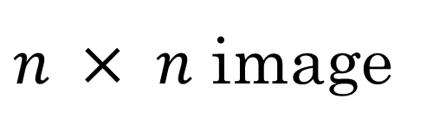
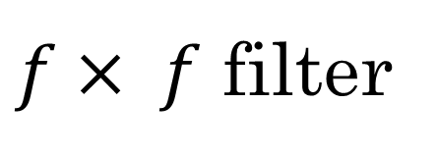
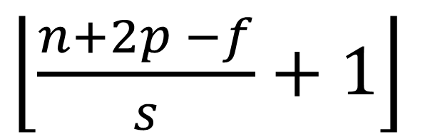

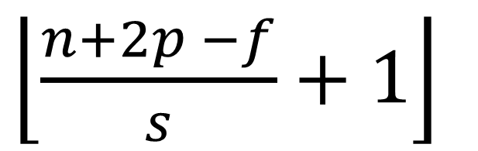
Summary of convolutions
$n × n$ image
$f× f$ filter
padding p
stride s
$\left\lfloor \frac{n+2p −f}{s}+1\right\rfloor$
$\left\lfloor \frac{n+2p −f}{s}+1\right\rfloor$
$$×$$

Slide 18

Technical note on cross-correlation vs. convolution
Convolution in math textbook:
2 | 3 | 7 | 4 | 6 | 2
6 | 6 | 9 | 8 | 7 | 4
3 | 4 | 8 | 3 | 8 | 9
7 | 8 | 3 | 6 | 6 | 3
4 | 2 | 1 | 8 | 3 | 4
3 | 2 | 4 | 1 | 9 | 8
3 | 4 | 5
1 | 0 | 2
-1 | 9 | 7
$$∗$$

Slide 19
Convolutional Neural Networks
Convolutions over volumes
deeplearning.ai

Slide 20
Convolutions on RGB images

Slide 21


Convolutions on RGB image
$$∗$$
$$=$$
4 x 4

Slide 22




Multiple filters
$$∗$$
$$=$$
3 x 3 x 3
4 x 4
6 x 6 x 3
$$∗$$
$$=$$
3 x 3 x 3
4 x 4

Slide 23
Convolutional Neural Networks
A simple convolution network example
deeplearning.ai

Slide 24
Example ConvNet

Slide 25
Types of layer in a convolutional network:
- Convolution
- Pooling
- Fully connected

Slide 26
Convolutional Neural Networks
Pooling layers
deeplearning.ai

Slide 27
Pooling layer: Max pooling
1 | 3 | 2 | 1
2 | 9 | 1 | 1
1 | 3 | 2 | 3
5 | 6 | 1 | 2

Slide 28
Pooling layer: Max pooling
1 | 3 | 2 | 1 | 3
2 | 9 | 1 | 1 | 5
1 | 3 | 2 | 3 | 2
8 | 3 | 5 | 1 | 0
5 | 6 | 1 | 2 | 9

Slide 29
Pooling layer: Average pooling
1 | 3 | 2 | 1
2 | 9 | 1 | 1
1 | 4 | 2 | 3
5 | 6 | 1 | 2

Slide 30
Summary of pooling
Hyperparameters:
f : filter size
s : stride
Max or average pooling

Slide 31
Convolutional Neural Networks
Convolutional neural network example
deeplearning.ai

Slide 32
Neural network example

Slide 33
Neural network example
 | Activation shape | Activation Size | # parameters
Input: | (32,32,3) | 3,072 | 0
CONV1 (f=5, s=1) | (28,28,8) | 6,272 | 208
POOL1 | (14,14,8) | 1,568 | 0
CONV2 (f=5, s=1) | (10,10,16) | 1,600 | 416
POOL2 | (5,5,16) | 400 | 0
FC3 | (120,1) | 120 | 48,001
FC4 | (84,1) | 84 | 10,081
Softmax | (10,1) | 10 | 841

Slide 34
Convolutional Neural Networks
Why convolutions?
deeplearning.ai

Slide 35
Why convolutions

Slide 36


Why convolutions
10 | 10 | 10 | 0 | 0 | 0
10 | 10 | 10 | 0 | 0 | 0
10 | 10 | 10 | 0 | 0 | 0
10 | 10 | 10 | 0 | 0 | 0
10 | 10 | 10 | 0 | 0 | 0
10 | 10 | 10 | 0 | 0 | 0
0 | 30 | 30 | 0
0 | 30 | 30 | 0
0 | 30 | 30 | 0
0 | 30 | 30 | 0
1 | 0 | -1
1 | 0 | -1
1 | 0 | -1
$$∗$$
$$=$$
Parameter sharing: A feature detector (such as a vertical edge detector) that’s useful in one part of the image is probably useful in another part of the image.
Sparsity of connections: In each layer, each output value depends only on a small number of inputs.

Slide 37


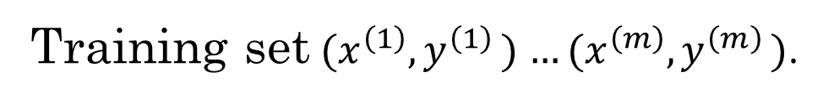
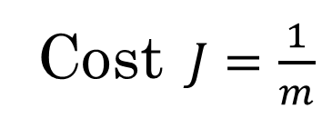

Putting it together
Training set$(x^{\left(1\right)}{,y}^{\left(1\right)})$ $…(x^{\left(m\right)}{,y}^{\left(m\right)})$.
$$\hat{y}$$
Cost $J=\frac{1}{m}$
$$\sum_{i=1}^{m}{ }$$
$$ℒ({\hat{y}}^{\left(i\right)},y^{\left(i\right)})$$
Use gradient descent to optimize parameters to reduce $J$

